Slide 1
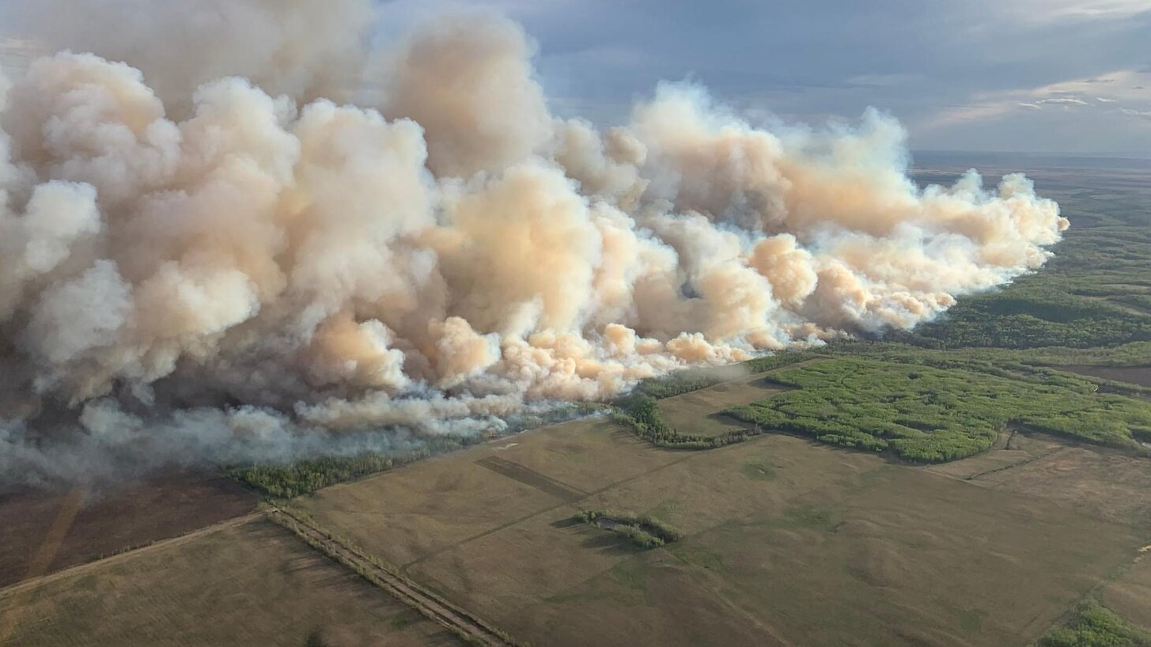
Analysis of Wildfire Smoke and Its Impact on Respiratory Health of Madison, WI
Manasa Shivappa Ronur

Slide 2

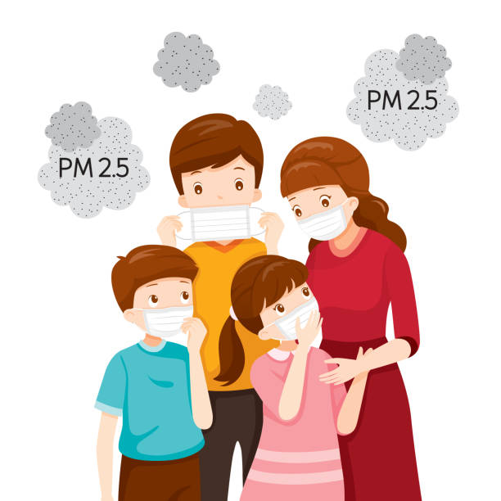
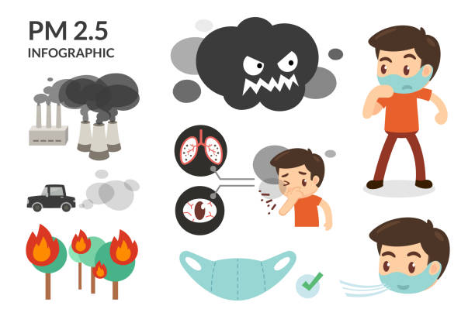
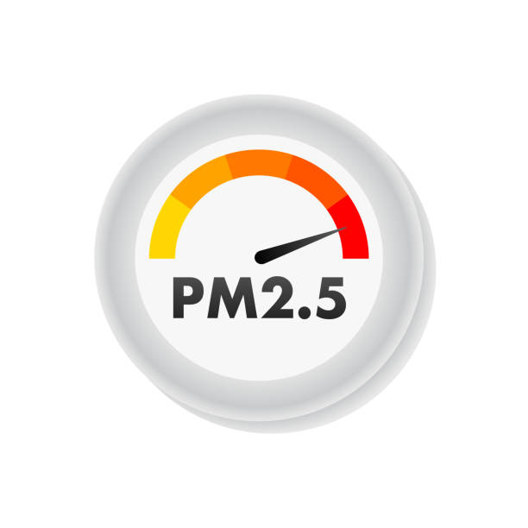
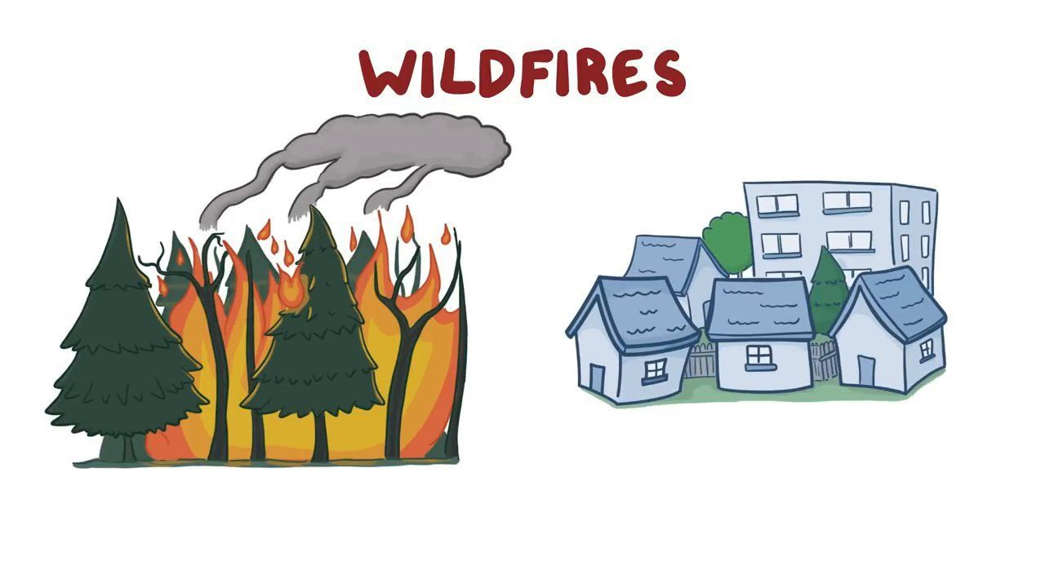


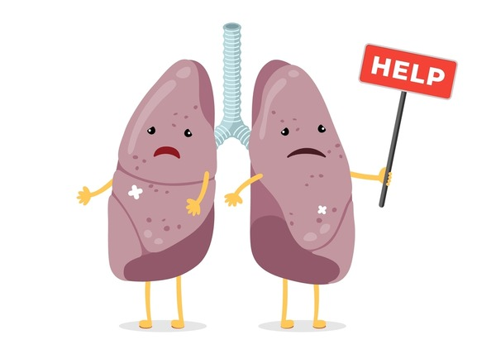


PROJECT GOAL
To study wildfire smoke trends and their impact on respiratory health in Madison, WI, focusing on asthma, COPD, and TB.
To help inform the city council and residents about the potential future health impacts of smoke.

Slide 3
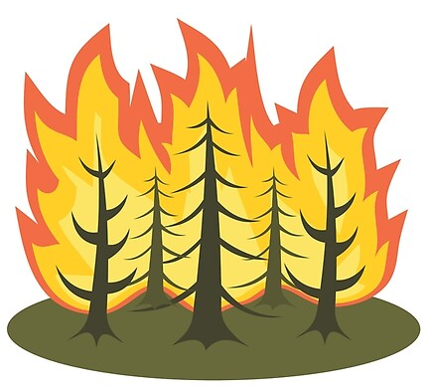

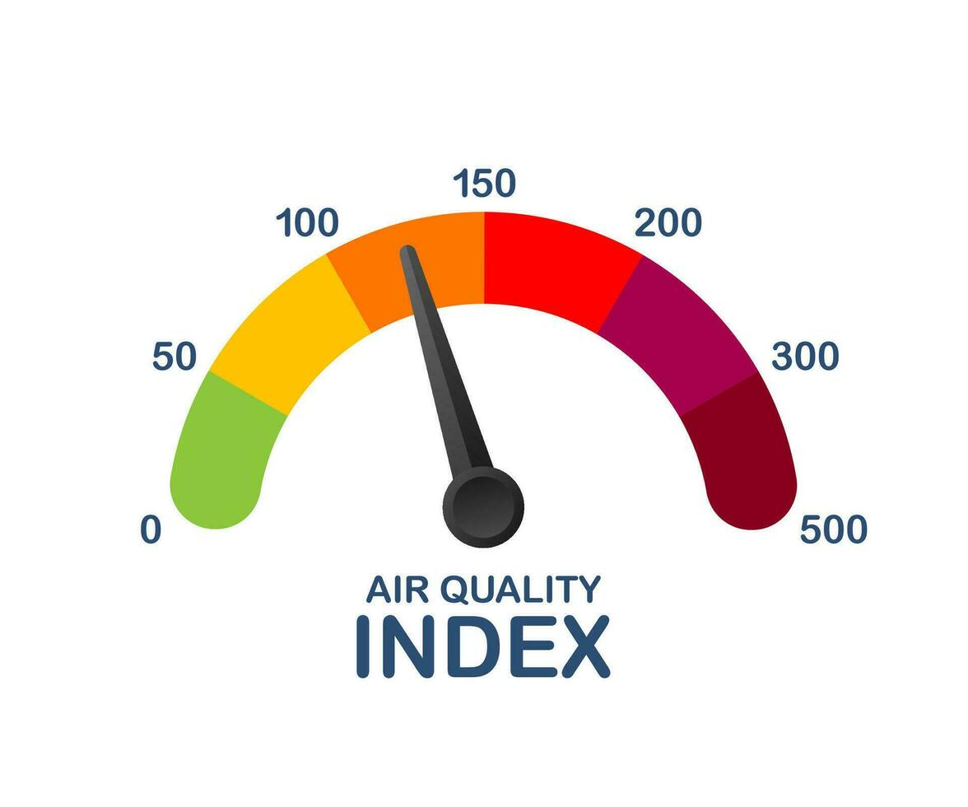


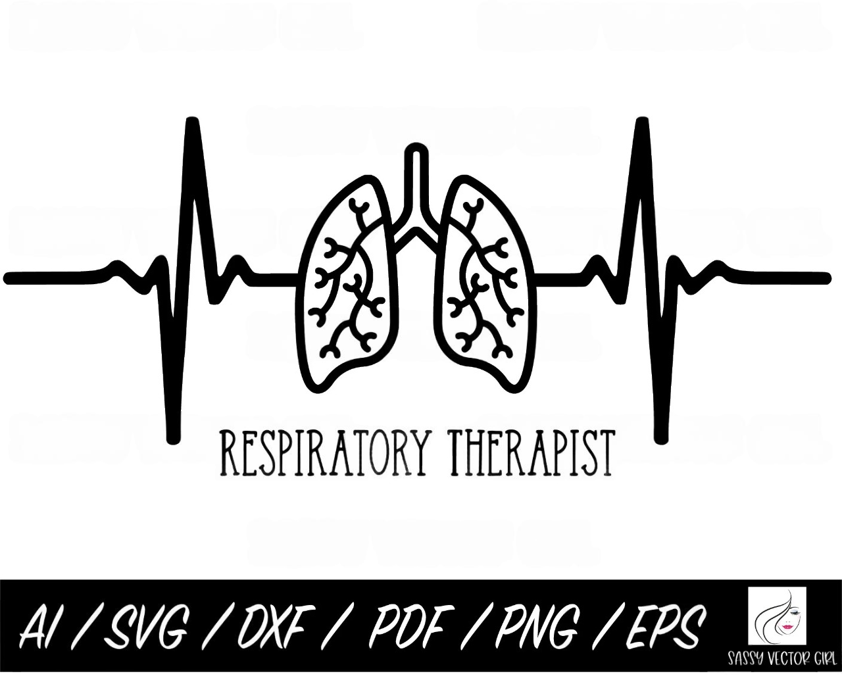

APPROACH
1
2
3
4
1 2 3 4 5

Slide 4








DATA SOURCE
Smoke Estimation and Evaluation
Respiratory Health Metrics
Wildfire
AQI
Illness
Mortality
Asthma
COPD
Tuberculosis
United Sates Environmental Protection Agency
Institute for Health Metric and Evaluation

Slide 5

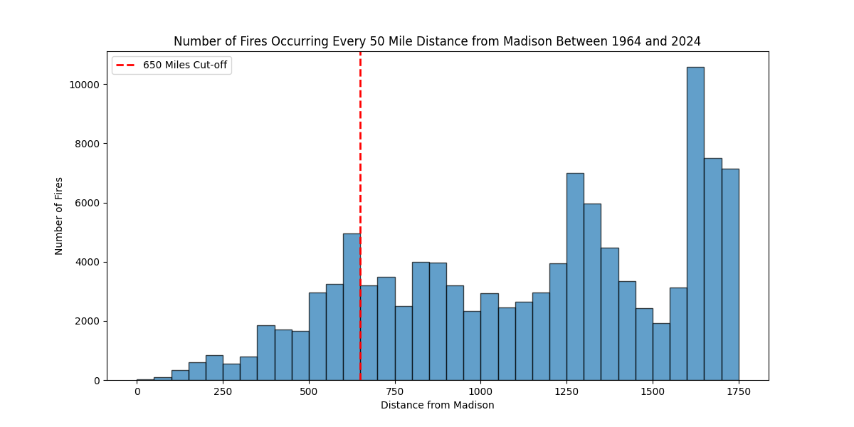
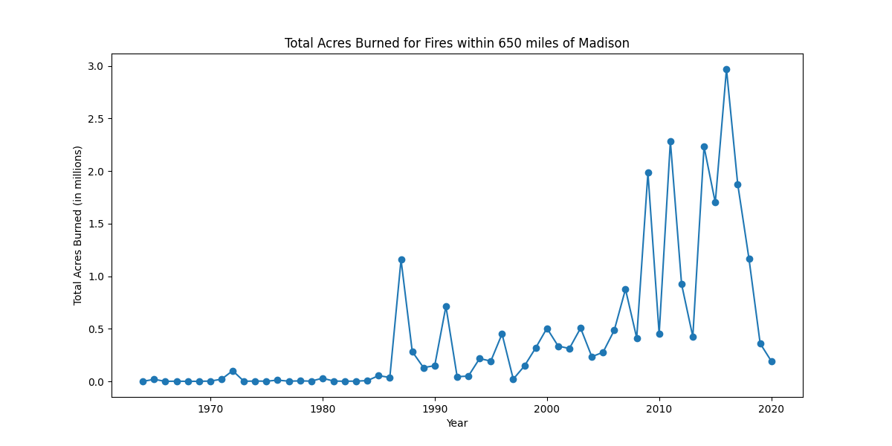

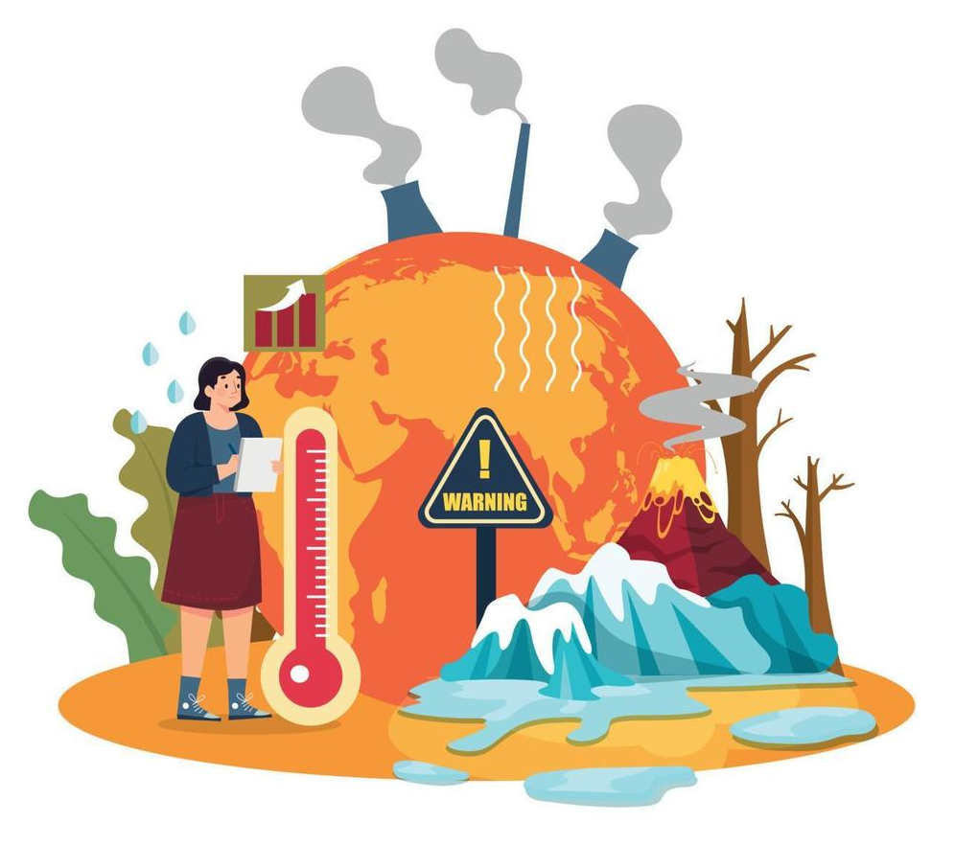
INITIAL FINDINGS

Slide 6

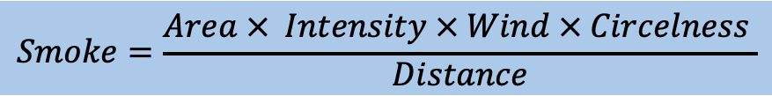
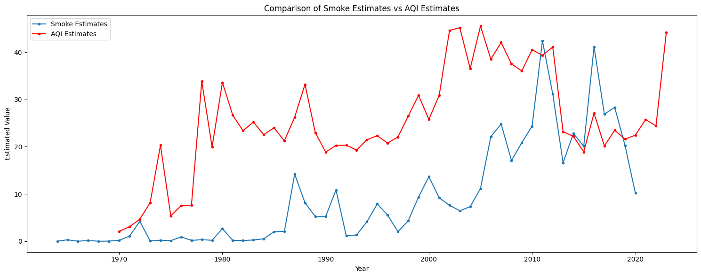
SMOKE ESTIMATION AND EVALUATION
Correlation Value : 0.49
P-Value : 0.00095

Slide 7
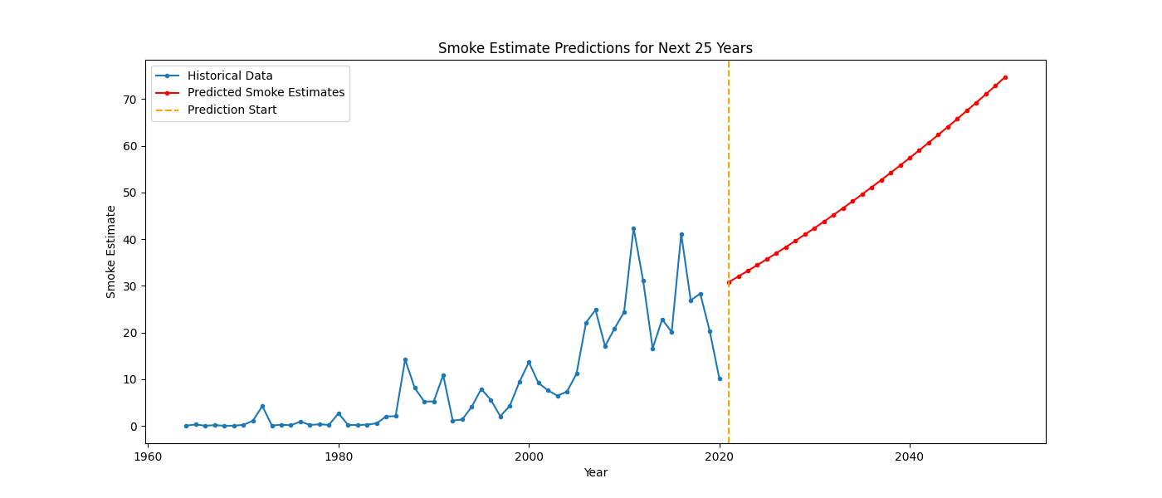
SMOKE PREDICTION

Slide 8
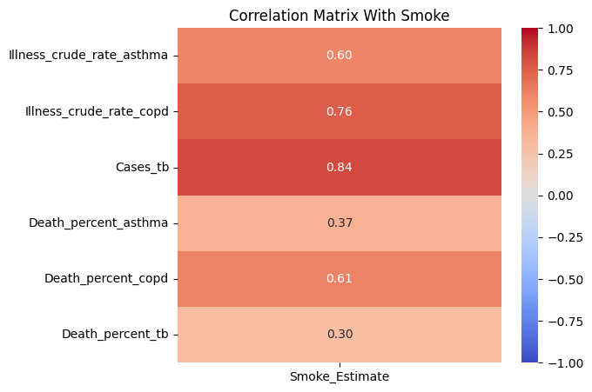
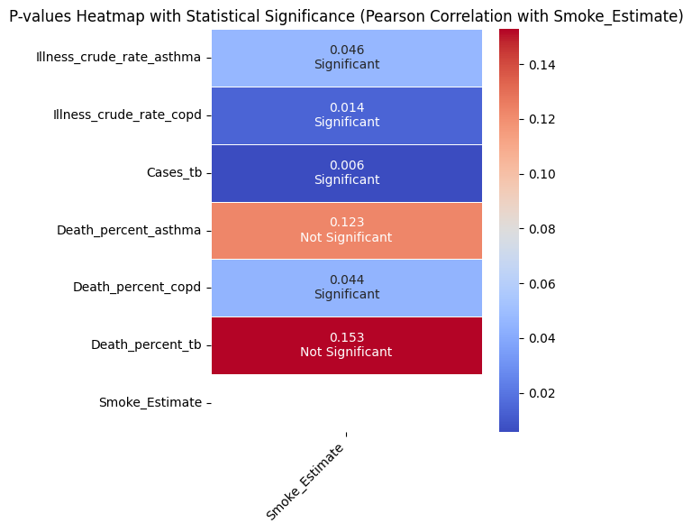
CORRELATION BETWEEN SMOKE ESTIMATE AND HEALTH METRICS
Correlation Matrix
P-Value using Pearson Correlation

Slide 9
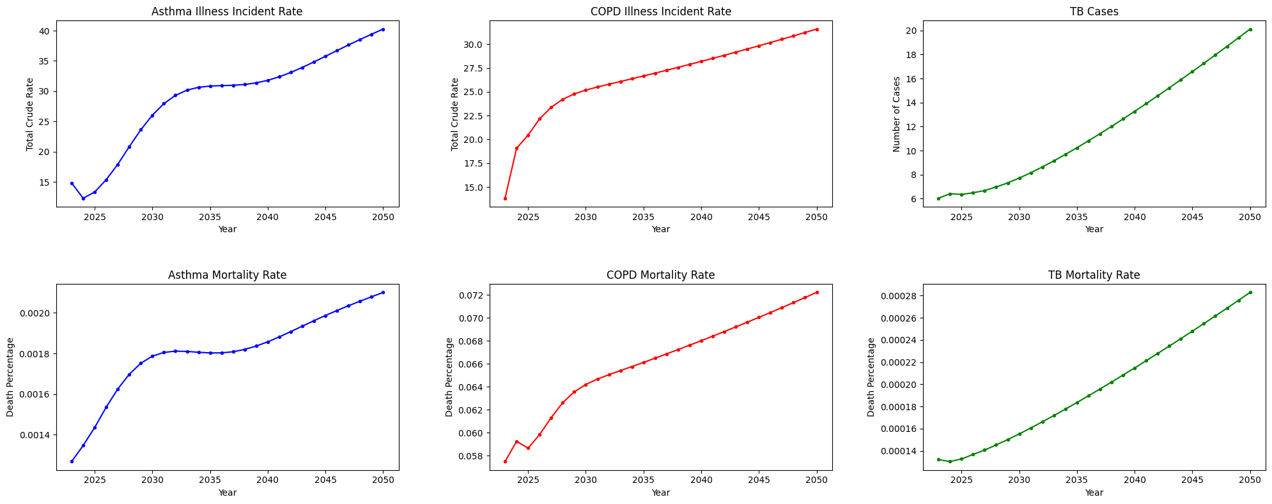
PREDICTED HEALTH IMPACT

Slide 10
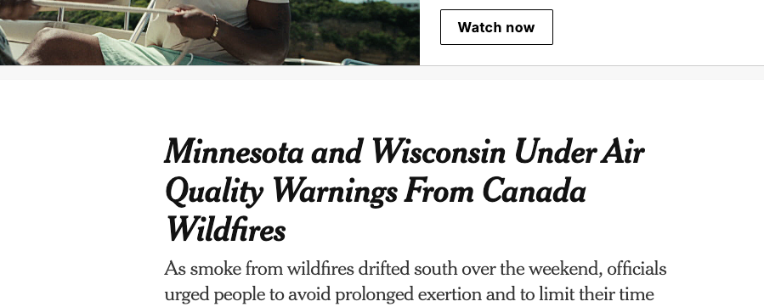
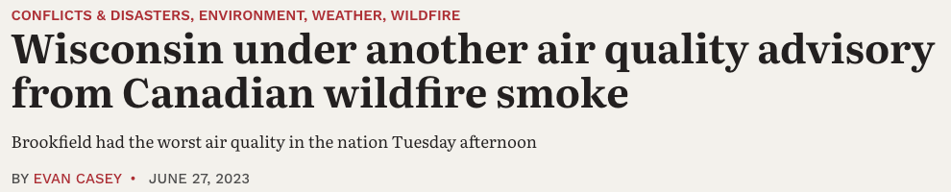
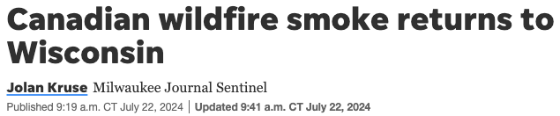
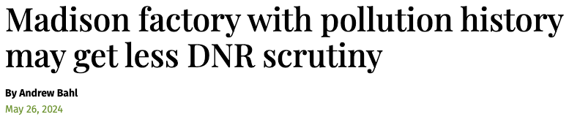
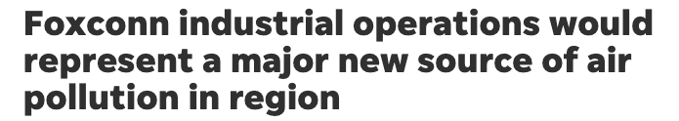
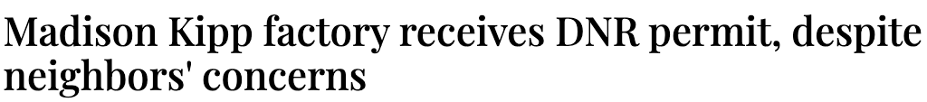
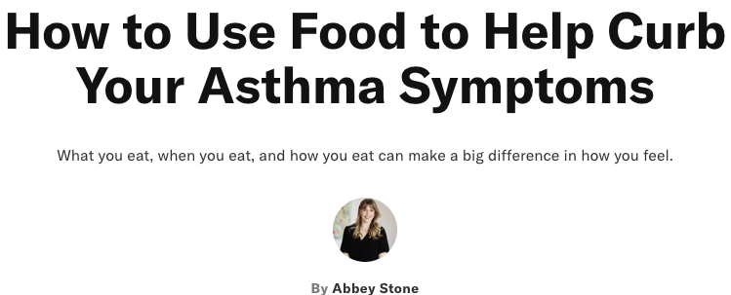
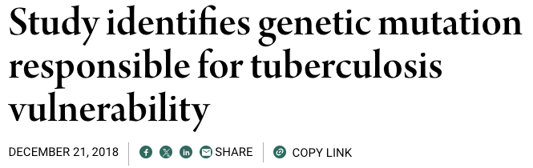
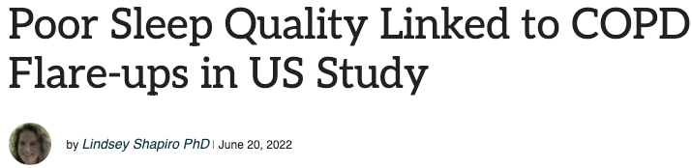
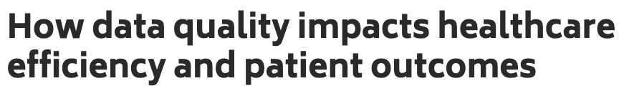
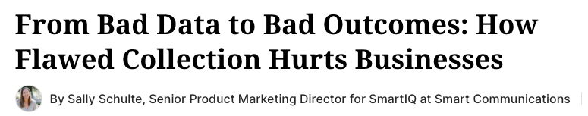
LIMITATIONS AND CONSIDERATIONS

Slide 11








CONCLUSION
KEY FINDINGS
Smoke is linked to Illness
Rise in Health Risks
Many variables remain unexplored, offering opportunities for further research
RECOMMENDATIONS FOR POLICY MAKERS
Environmental Awareness
Clean Air Shelters
Increase Medical Resources

